Slide 1
Capstone Project Hotel Booking Analysis
MD Kamran
Rishabh Gupta
Reena Verma
Krunal Sonare
Mithin Barde

Slide 2
Points to Discuss:
Agenda
Data summary
Hotel wise analysis
Distribution Channel wise analysis
Booking cancellation analysis
Line graph
Bar Chart
Correlation Heat-map
Conclusion

Slide 3
Agenda
We would be discussing the summary of the data.
Capstone Project Questions with the explanation of the answers and charts.

Slide 4
Data Summary
Given data set has different columns of variables crucial for hotel bookings. Some of them are:
Hotel: The category of hotels, which are two resort hotel and city hotel.
is_cancelled : The value of column show the cancellation type. If the booking was cancelled or not.
Values[0,1], where 0 indicates not cancelled.
lead_time : The time between reservation and actual arrival.
stayed_in_weekend_nights: The number of weekend nights stay per reservation
stayed_in_weekday_nights: The number of weekday nights stay per reservation. meal: Meal preferences per reservation.[BB,FB,HB,SC,Undefined]
Country: The origin country of guest.

Slide 5
Data Summary(contd..)
Market_segment: This column show how reservation was made and what is the purpose
of reservation. Eg, corporate means corporate trip, TA for travel agency.
distribution_channel: The medium through booking was made.[Direct,Corporate,TA/TO,undefined,GDS.]
Is_repeated_guest: Shows if the guest is who has arrived earlier or not.Values[0,1]-->0
indicates no and 1 indicated yes person is repeated guest.
days_in_waiting_list: Number of days between actual booking and transact.
customer_type: Type of customers( Transient, group, etc.)

Slide 6
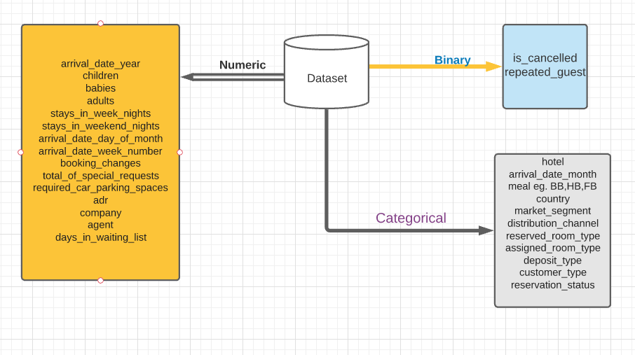
Data sets Summary

Slide 7
Capstone Project Questions
While doing a univariate analysis of a given hotel booking dataset, we answered the following questions:
Q1Which meal type is the most preferred meal of customers?
Q2 Which agent makes the most no. of bookings?
Q3 Which room_type is in most demand and which room_type generates the highest adr?
Q4 What is the Booking Percentage in each hotel?
Q5 Which among the hotel has higher which has a lower lead time?
Q6 which hotel seems to make more revenue?
Q7 Which hotel has a longer waiting time and which has less waiting time?
Q8 Arrival of booking from diff segments?
Q9 Deposite whether it is refundable nonrefundable or no deposit?
Q10 Arrivals in different month comparison?
Q11 No of cancellation per month data?
Q12 No of passengers by cancellation by the types of hotels?
Q13 Meals type by no of passengers that were preferred to eat by the passengers?

Slide 8
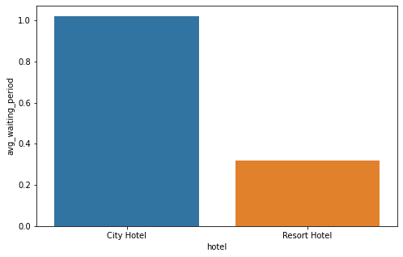
Q1 Which hotel has longer waiting time and which has less waiting time ?
Ans:- The city hotel has a significantly longer waiting time, hence City Hotel is much busier than Resort Hotel
1) When we show a relationship between the waiting list in days and the avg. waiting period time
2) In the data frame we find that city hotel has longer waiting time as compared to resort hotels
3) The result shows more profit for city hotels
4) Resort hotel has worked on there revenue model to get more profit as compared to city hotels

Slide 9
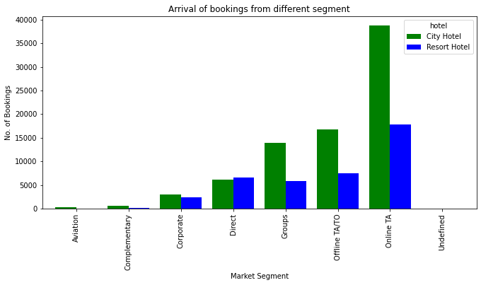
Q2 Arrival of booking from diff segments?
Ans:- Booking from the different segment types.
1) looking forward from different segments between hotel and market segments and the number of booking from online TA is the most beneficial sector for city hotels as compared to the resort hotel
2) According to the graph the green color shows the percentage of booking for a city hotel and the blue color shows the percentage of resort hotels the booking in the graph with higher booking from online TA.

Slide 10
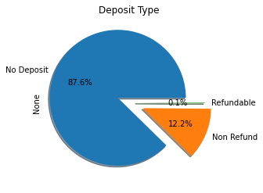
Q3 Deposite whether it is refundable nonrefundable or no depoist?
Ans:-Percentage of each type of deposit
we can represent our data from different methods and one of the most important methods is the pie chart
1) In the chart out of 100 percent 87.6% are no deposits
2) Out of 100 percent 12.2% are non-refundable
3) the rest of 0.1% is refundable which is less than among of no refund and no deposits

Slide 11
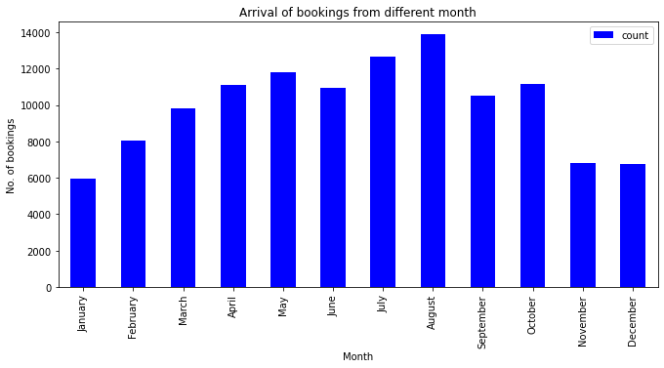
Q4 Arrivals in different month comparision?
Ans:-Different month comparison
1)Number of arrival rises steadily till august
and sharply decline from November.
2)Highest arrival in months are July and
August.
3)November, December and January saw
The least number of guests.

Slide 12
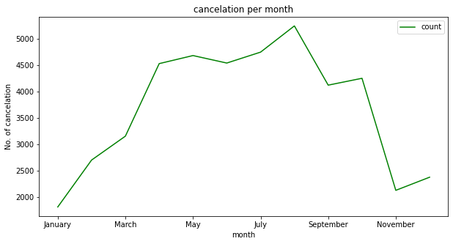
Q5 No of cancellation per month data ?
Ans:-Cancellation per month data
1)Month of august has the highest number of cancelation.
2)Although November and December has almost same booking , cancelation rate in December is more.
3)There is negligible change in cancelation between September and october.

Slide 13
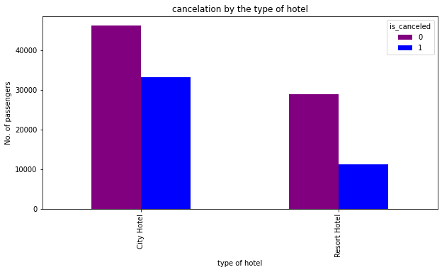
Q6 No of passengers by cancellation by the types of hotels?
Ans:-Cancelation by the types of hotels
1) Most bookings were in a city hotel
2) Cancelations in Resort hotel is less
compared to city hotel

Slide 14
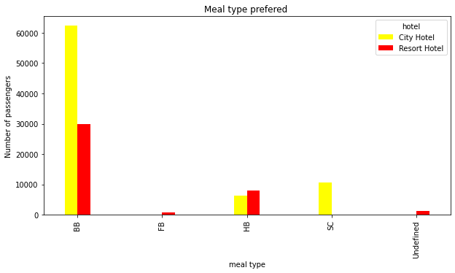
Q7.Meals type by no of pessengers that were preffered to eat by the pessengers?
Ans:-Most ordered meal type
Out of the meals, BB (Bed & Breakfast) is the most ordered meal which is around 77.2%,
HB(Half Board) around 12.1%
SC(no meal package) around 0.89%
Undefined and FB (Full Board) around 0.09% and 0.06% respectively.

Slide 15
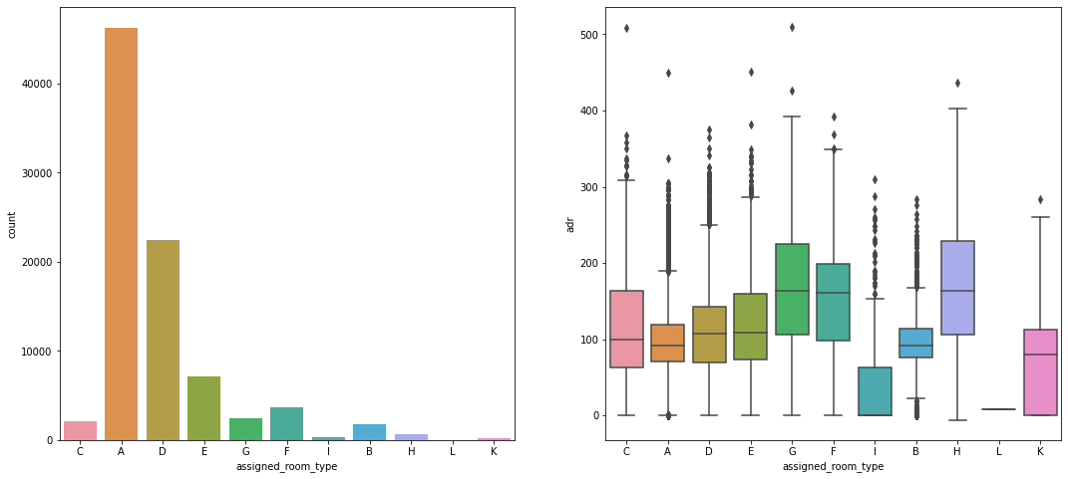
Q8 Which room_type is in most demand and which room_type generates highest adr?
Ans:-
Most demanded room type is A
Better adr rooms are of type H, G and C.
Hotels should increase the no. of room types A and H to maximise revenue.

Slide 16
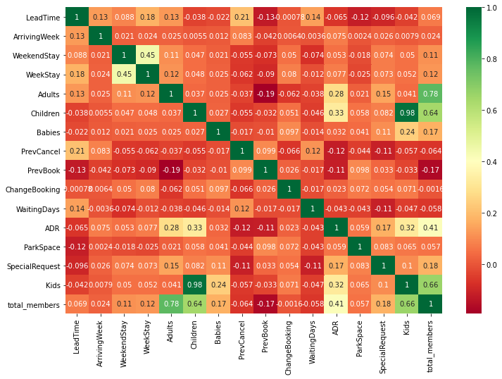
Lets see the correlation

Slide 17
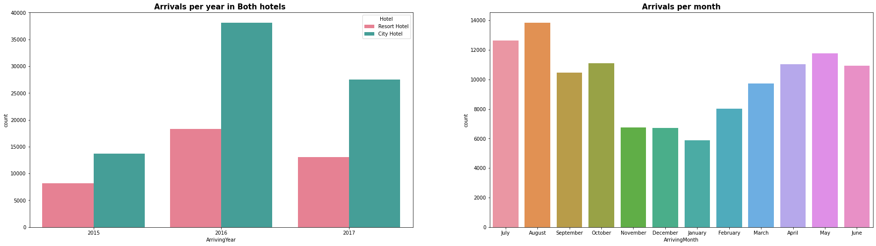
Q.9 Which year had host number of booking ?
Ans:- 1) 47% bookings were done in 2016.
2)34% booking were done in 2017.
3)18 % booking were done in 2015..
4)We can see increasing tendency in bookings year wise

Slide 18
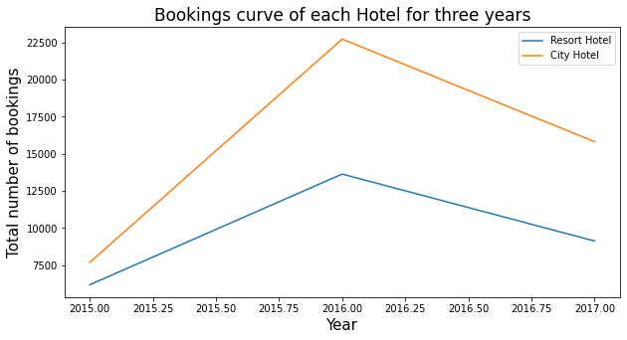
Booking curve of each hotel for three years
1)In a single glance we can see that no matter which year the overall bookings are more for City Hotel in comparison to Resort Hotel
2)We can also see that the bookings, (or sales because that's what they are) have fallen for both the hotels from the year 2016 onwards but for Resort Hotel they have fallen more sharply!

Slide 19
Mainly performed using Matplotlib and Seaborn library and the following graph and plots had been used:
Heat-map.—Correlation Matrix
Scatter Plot.--- Scatter Plot Data Analysis
Bar Chart --- Bar plot
Pie Chart. --- Pie plot
Line Plot.
Box Plot

Slide 20
Conclusion
When we show a relationship between the waiting list in days and the avg. waiting period time
In the data frame we find that city hotel has longer waiting time as compared to resort hotels
The result shows more profit for city hotels
Resort hotel has worked on its revenue model to get more profit as compared to city hotels
4. Out of the meals, BB (Bed & Breakfast) is the most ordered meal which is around 77.2%,
5. HB(Half Board) around 12.1%
6. SC(no meal package) around 0.89%
Undefined and FB (Full Board) around 0.09% and 0.06% respectively.
8. Number of arrival rises steadily till august and sharply decline from November.
9. From reservation_status it is clear that though City Hotel is 64% Resort Hotel has more number of guests and City Hotel has more number of Cancellation as compare to Resort Hotel
10. From market_segment and distribution_channel we can observe that City Hotel is more into 'Online TA' and Resort Hotel is more into 'Direct' segment.
11. From the meal we can observe that City Hotel provides 'BB' and Resort Hotel provide 'HB'.
12. City Hotel is more non-refund as compared to Resort Hotel and. adr and children are positively correlated by 32%

Slide 21
Thank You

